Slide 1
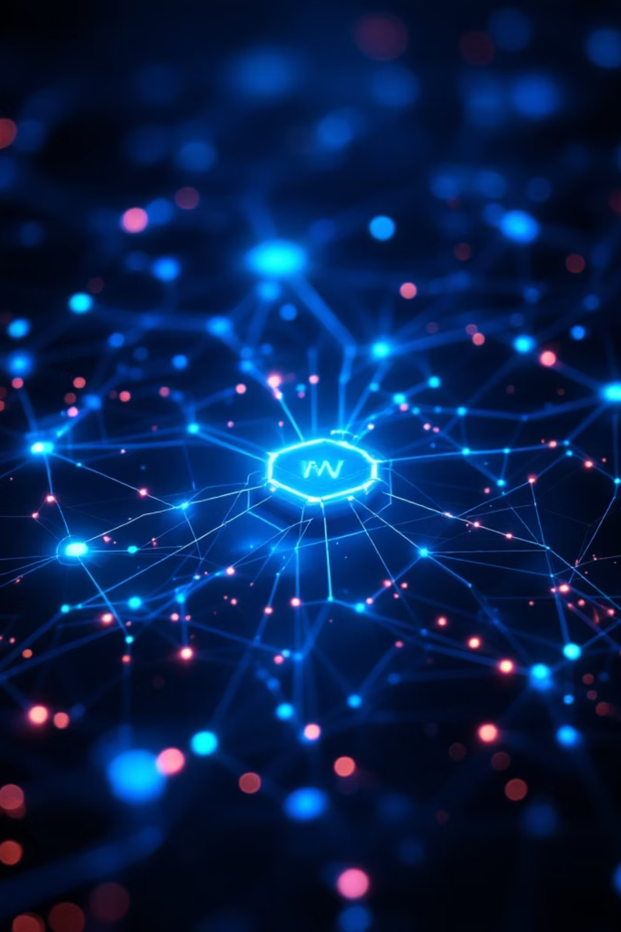
Cybersecurity Threat Intelligence Report (2024–2025)
Cybersecurity Analyst Internship — Task 1 (Awareness & Research Project)
Prepared by: [Gnaneshwar L] Date: [19/02/2026]

Slide 2
Table of Contents
1. Introduction to Cybersecurity
2. Modern Threat Landscape
3. AI-Powered Phishing
4. Ransomware-as-a-Service
5. Cloud Misconfigurations
6. IoT Vulnerabilities
7. Zero-Day Exploits
8. Impact Analysis
9. Preventive Framework
10. Conclusion & References

Slide 3

Introduction to Cybersecurity
Definition: Cybersecurity protects systems, networks and data from theft, damage, or disruption. It spans technical controls, policy, and human factors.
Why it matters in 2024–2025: AI-driven attacks, broad cloud adoption, and a surge in ransomware increase risk for individuals and organisations alike.

Slide 4
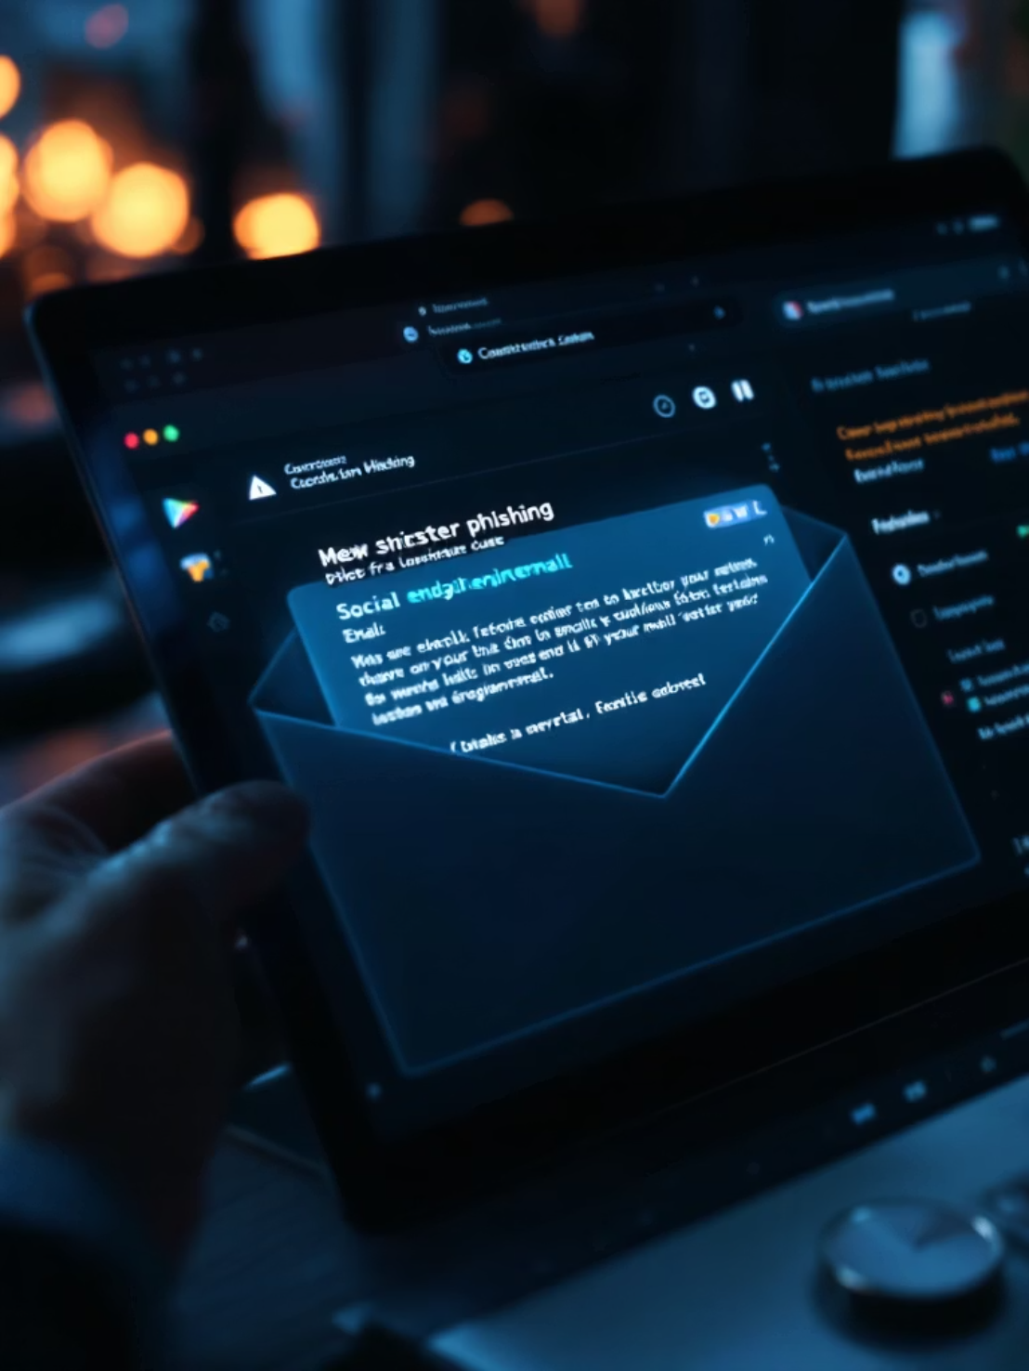
AI-Powered Phishing & Deepfakes
Threats: AI-generated phishing messages mimic tone and context; deepfake audio/video enable convincing social engineering and BEC (Business Email Compromise).
Case: 2024 Hong Kong deepfake scam — reported multi‑million-dollar loss (≈ $25M) demonstrates scale and realism.
Mitigations: Enforce MFA, deploy AI-based email filtering, and run continuous employee awareness and simulation training.

Slide 5
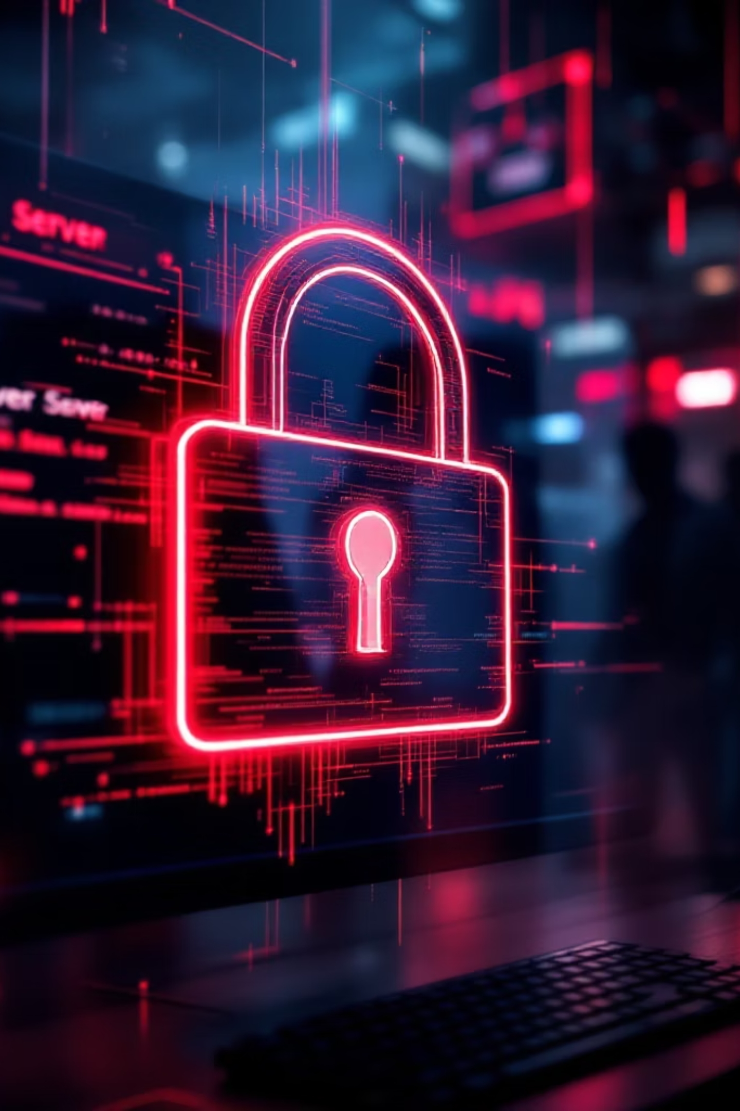
Ransomware-as-a-Service (RaaS)
What is RaaS?
Commercialised ransomware kits rented to affiliates — lowers entry barrier for cybercriminals.
Typical Tactics
Double extortion: data encryption plus exfiltration and public shaming to force payment.
Example & Impact
Colonial Pipeline: critical infrastructure disruption, economic impact, and supply-chain effects.
Defensive Actions
Maintain offline backups, apply network segmentation, and use Endpoint Detection & Response (EDR).

Slide 6
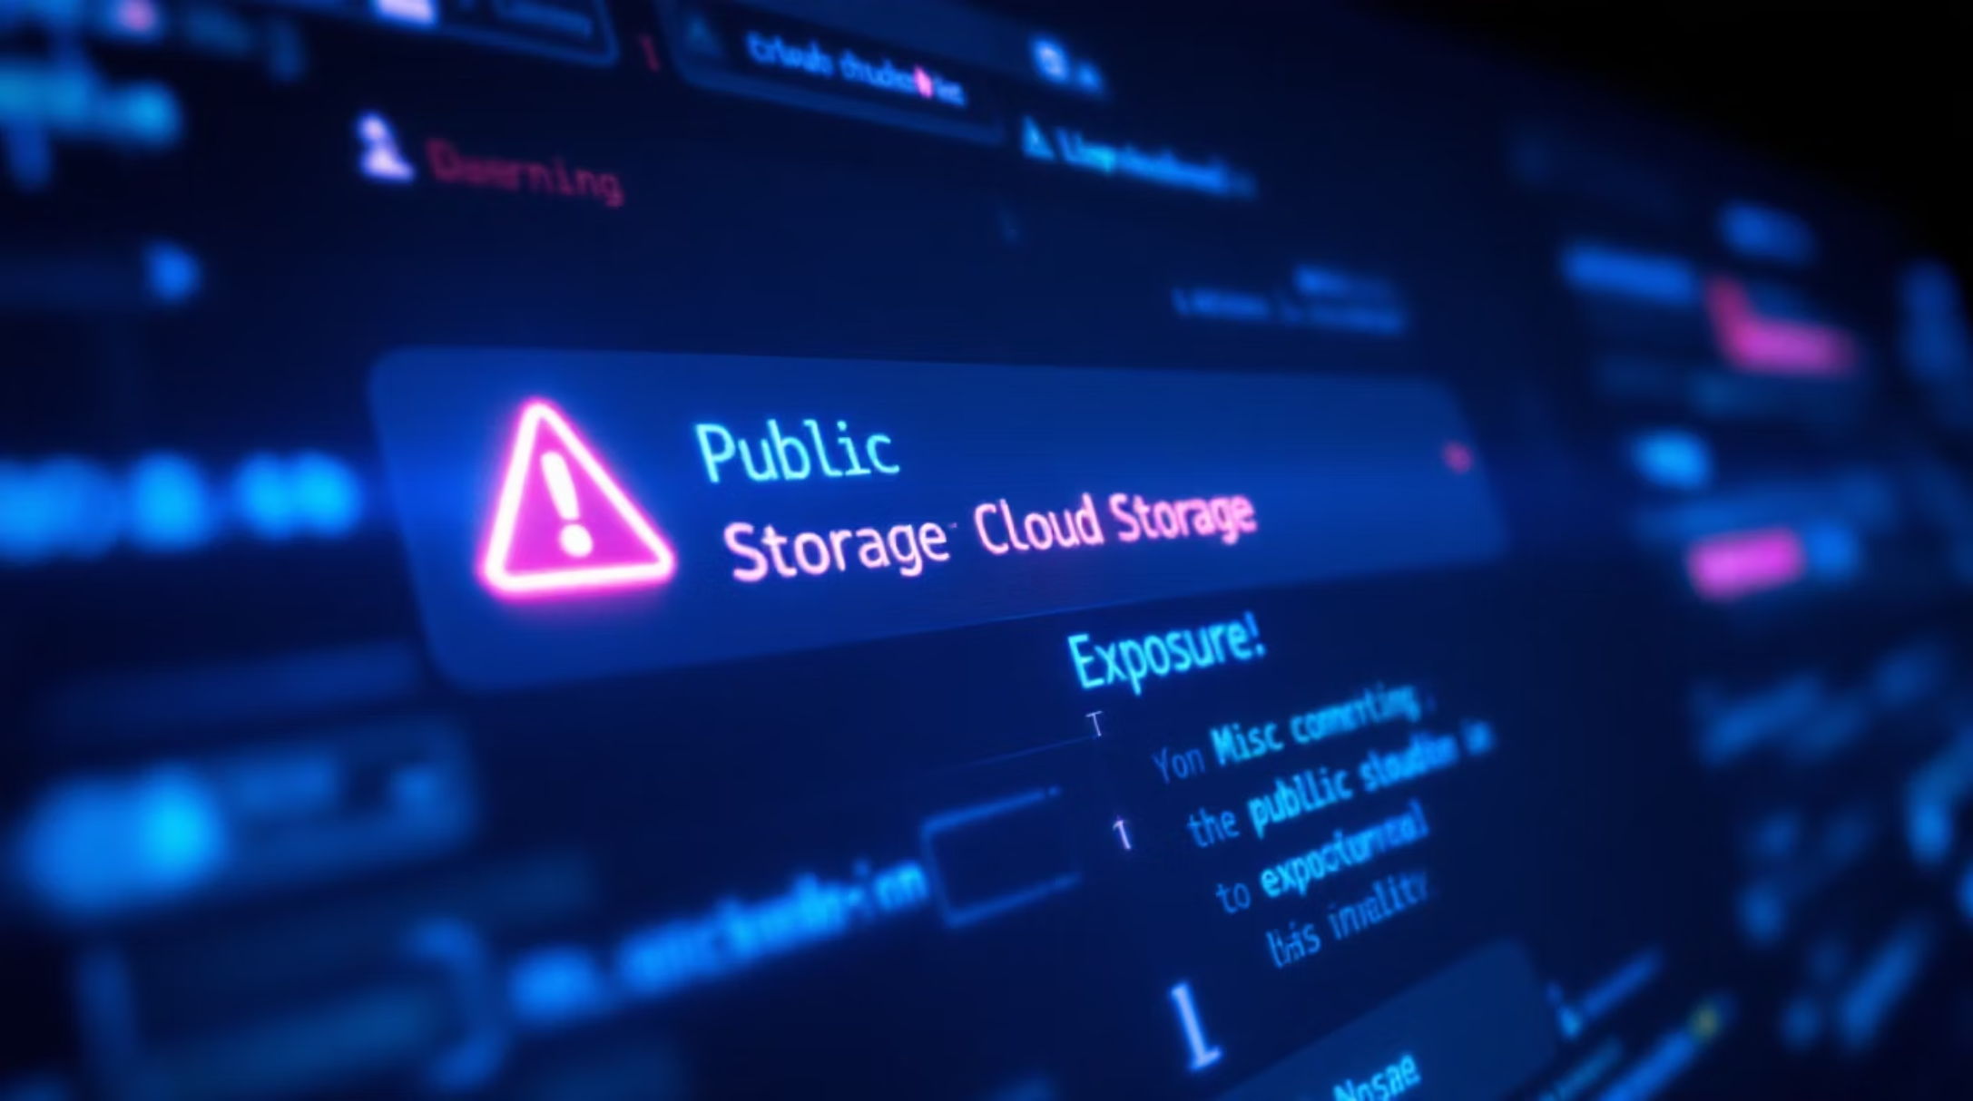
Cloud Security Misconfigurations
Common Issues: Public storage exposure, weak IAM policies, mismanaged credentials and excessive privileges.
Historical Breach: Capital One — misconfiguration in cloud firewall/ACLs led to data exfiltration and regulatory consequences.
Controls: Implement CSPM, enforce RBAC, rotate credentials, and perform scheduled cloud audits.

Slide 7

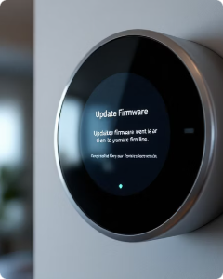
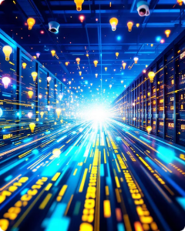
IoT Vulnerabilities
Weak Credentials
Outdated Firmware
Botnets
Default or weak passwords allow rapid compromise and lateral movement.
Unpatched devices expose known exploits and long-term persistence risks.
Mirai exemplifies large-scale DDoS using hijacked IoT devices, impacting DNS and services.
Practical defenses: change defaults, schedule firmware updates, and isolate IoT on a segmented network.

Slide 8
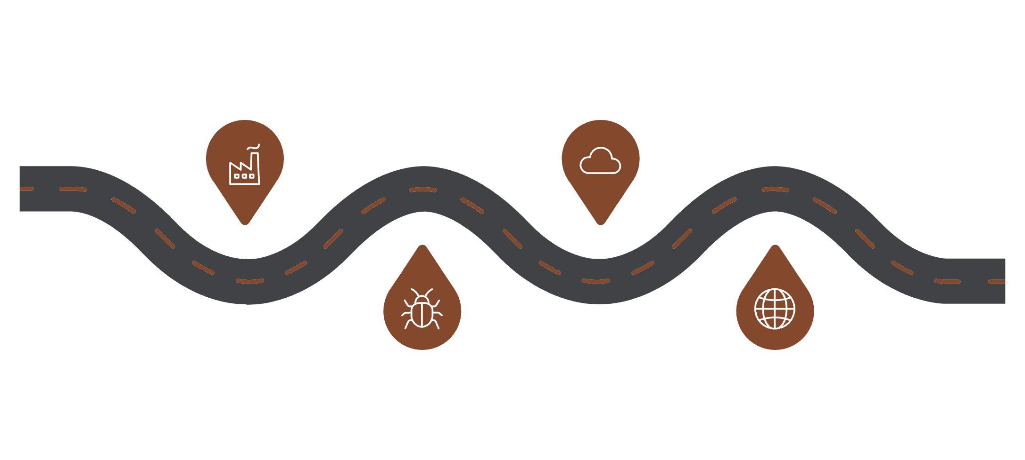

Zero-Day Exploits & Supply-Chain Risks
Vendor Build
Software Update
Why Dangerous: No prior signature or patch; high-confidence exploitation and broad reach.
Trusted development and packaging
Signed update delivered via normal channels
Notable Case: SolarWinds — coordinated supply-chain compromise affecting many organisations and public sector entities.
Malicious Injection
Wide Impact
Customers receive exploit leading to breach
Mitigations: Adopt Zero Trust, deploy IDS/IPS, apply continuous patching and software bill-of-materials (SBOM) reviews.
Stealthy backdoor inserted into code
Supply-chain attacks weaponize trusted software update mechanisms to distribute zero-day payloads.

Slide 9
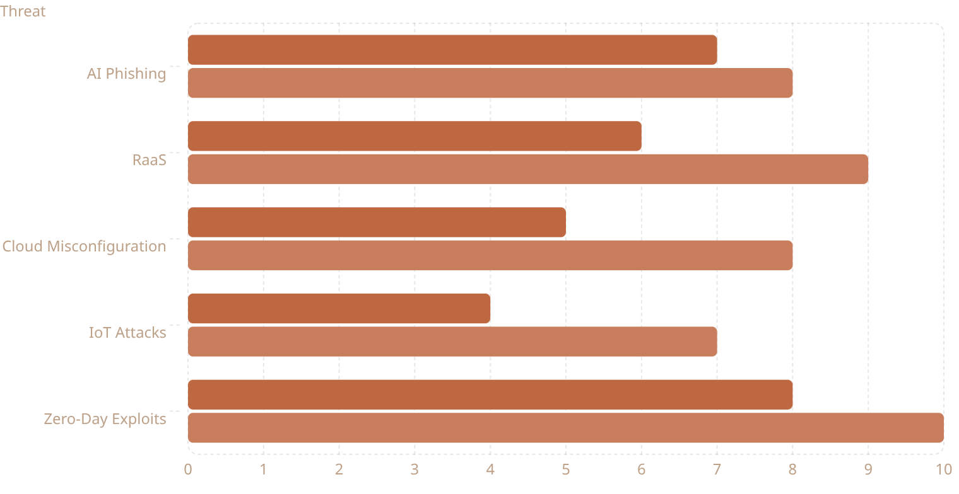
Impact Analysis — Comparative Table
Individual Impact (score 1-10)
Organizational Impact (score 1-10)
Scores are qualitative estimations of likely impact severity. Zero-day and RaaS pose highest systemic risk; AI phishing yields high targeted success rates against individuals and enterprises.

Slide 10
Preventive Framework, Conclusion & References
MFA & Identity Security
Zero Trust Model
Security Awareness
Enforce MFA and least-privilege access via RBAC and continuous authentication monitoring.
Segment networks, verify every session, and treat all resources as untrusted by default.
Ongoing phishing simulations and role-based training reduce human risk vectors.
Backups & Incident Response
Threat Intelligence
Regular offline backups, tested recovery plans, and EDR with playbooks are essential.
Monitor CISA alerts, integrate IOC feeds and threat-hunting into SOC operations.
Conclusion: Cyber threats are evolving rapidly; AI increases sophistication while cloud and supply-chain complexity amplify exposure. Proactive, layered defences and continuous learning are essential for resilience.
References
OWASP — Top Ten & Cloud Guidance
CISA — Cybersecurity Alerts & Advisories
IBM Security — Threat Intelligence Reports
KrebsOnSecurity — Investigative Reporting
NIST Cybersecurity Framework

